Slide 1
Interactive Succession Planning Workshop
David P. Singer
4/30/17

Slide 2
Do you want to be a Club President for Life?
What are the consequences of having a club president for life?
  Burn out a volunteer
  Club gets stale
  Club could close when the president steps down
  President doesn’t get to grow personally and take on new challenges
  New leaders aren’t developed.
  The president isn’t available to move up to the region or international organizations

Slide 3
What things would make it easier for you to step up to a leadership position?
What if you had a 1 VP and 2nd VP who will take over the next two two-year terms and who will share significant responsibilities with you?
What if you had 3 past presidents helping run your major programs? Immediate Past President chairs a nominating committee to find you new volunteers.
Leadership Database
  Listing each person's special skills, interests, availability, discussion log
Instructions Manual for all major programs

Slide 4
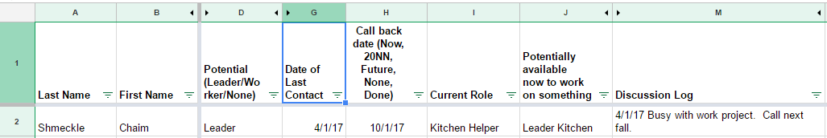
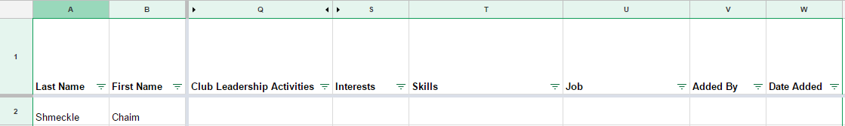
Leadership Database

Slide 5
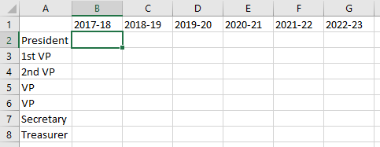
6 year plan Leadership Plan
With long-term planning people may be able to structure their lives to make a commitment
A “No” is not forever
Roles may flip over time, but knowing you are on the list changes your perspective.

Slide 6
Growth Ladder
Past
President
Intuitive natural progression
Set expectations
Reward excellence
An honor to serve
President
Pre-President
Officer
Officer
Committee Chair
Repeat for Regional and International Positions
Committee Member
* from Allan Kahan

Slide 7
Growth Ladder
Past
President
Intuitive natural progression
Set expectations
Reward excellence
An honor to serve
President
Pre-President
Officer
Officer
Committee Chair
Repeat for Regional and International Positions
Committee Member
* from Allan Kahan

Slide 8
Growth Ladder
Past
President
Intuitive natural progression
Set expectations
Reward excellence
An honor to serve
President
Pre-President
Officer
Officer
Committee Chair
Repeat for Regional and International Positions
Committee Member
* from Allan Kahan

Slide 9
How do you build a leadership pipeline?
Where does it all begin?
With personal conversations. Find out what they are passionate about. Find out their availability?
Build relationships.

Slide 10
Triad Management
Concept
  Three person Leadership for projects/areas of responsibility
    Current Leader - Elected Officer or Chairman – Has full responsibility
    Former Leader – Emeritus Officer or Former Chair – Consults/Supports
    Future Leader – Deputy VP or Co-Chair – Shares and is next in line
Benefit
  Continuity
  Grows leaders
  Expands involvement opportunities
* from Allan Kahan

Slide 11
When should the nominating committee be formed?
At the beginning of the officer term (June/July).
  The nominating can start getting to know the members in the leadership database; meeting them for coffee over the summer and fall months.
  The can also add members to the leadership database.
  Then when the call people in December and January, they will know who to ask what and these won’t be cold calls.
Start the formal nominating process before your synagogue does.

