Slide 1
How to Draw Young Men to Your Men’s Club? Marc Cohen

Slide 2
Role of Men’s Club
To strengthen, promote and advance the objectives and activities of the congregation.
Promote Jewish interest and commitment of its members.
Instill among its members and other laymen a more thorough knowledge and appreciation of Jewish heritage.
Sponsor and support activities of congregational youth and to further their Jewish education.
To support and strengthen the special role of the Conservative Movement within the total Jewish community.
To partner with and build relationships with the other groups of your shul.

Slide 3
Accomplishments
What have you done? What do you bring to the table of the shul?
Examples:
Increased number of members year over year.
Received Quality Club Award in 2014 from Mid Atlantic Region.
Ability to give back to TBS and have increased our donation to TBS year over year.

Slide 4
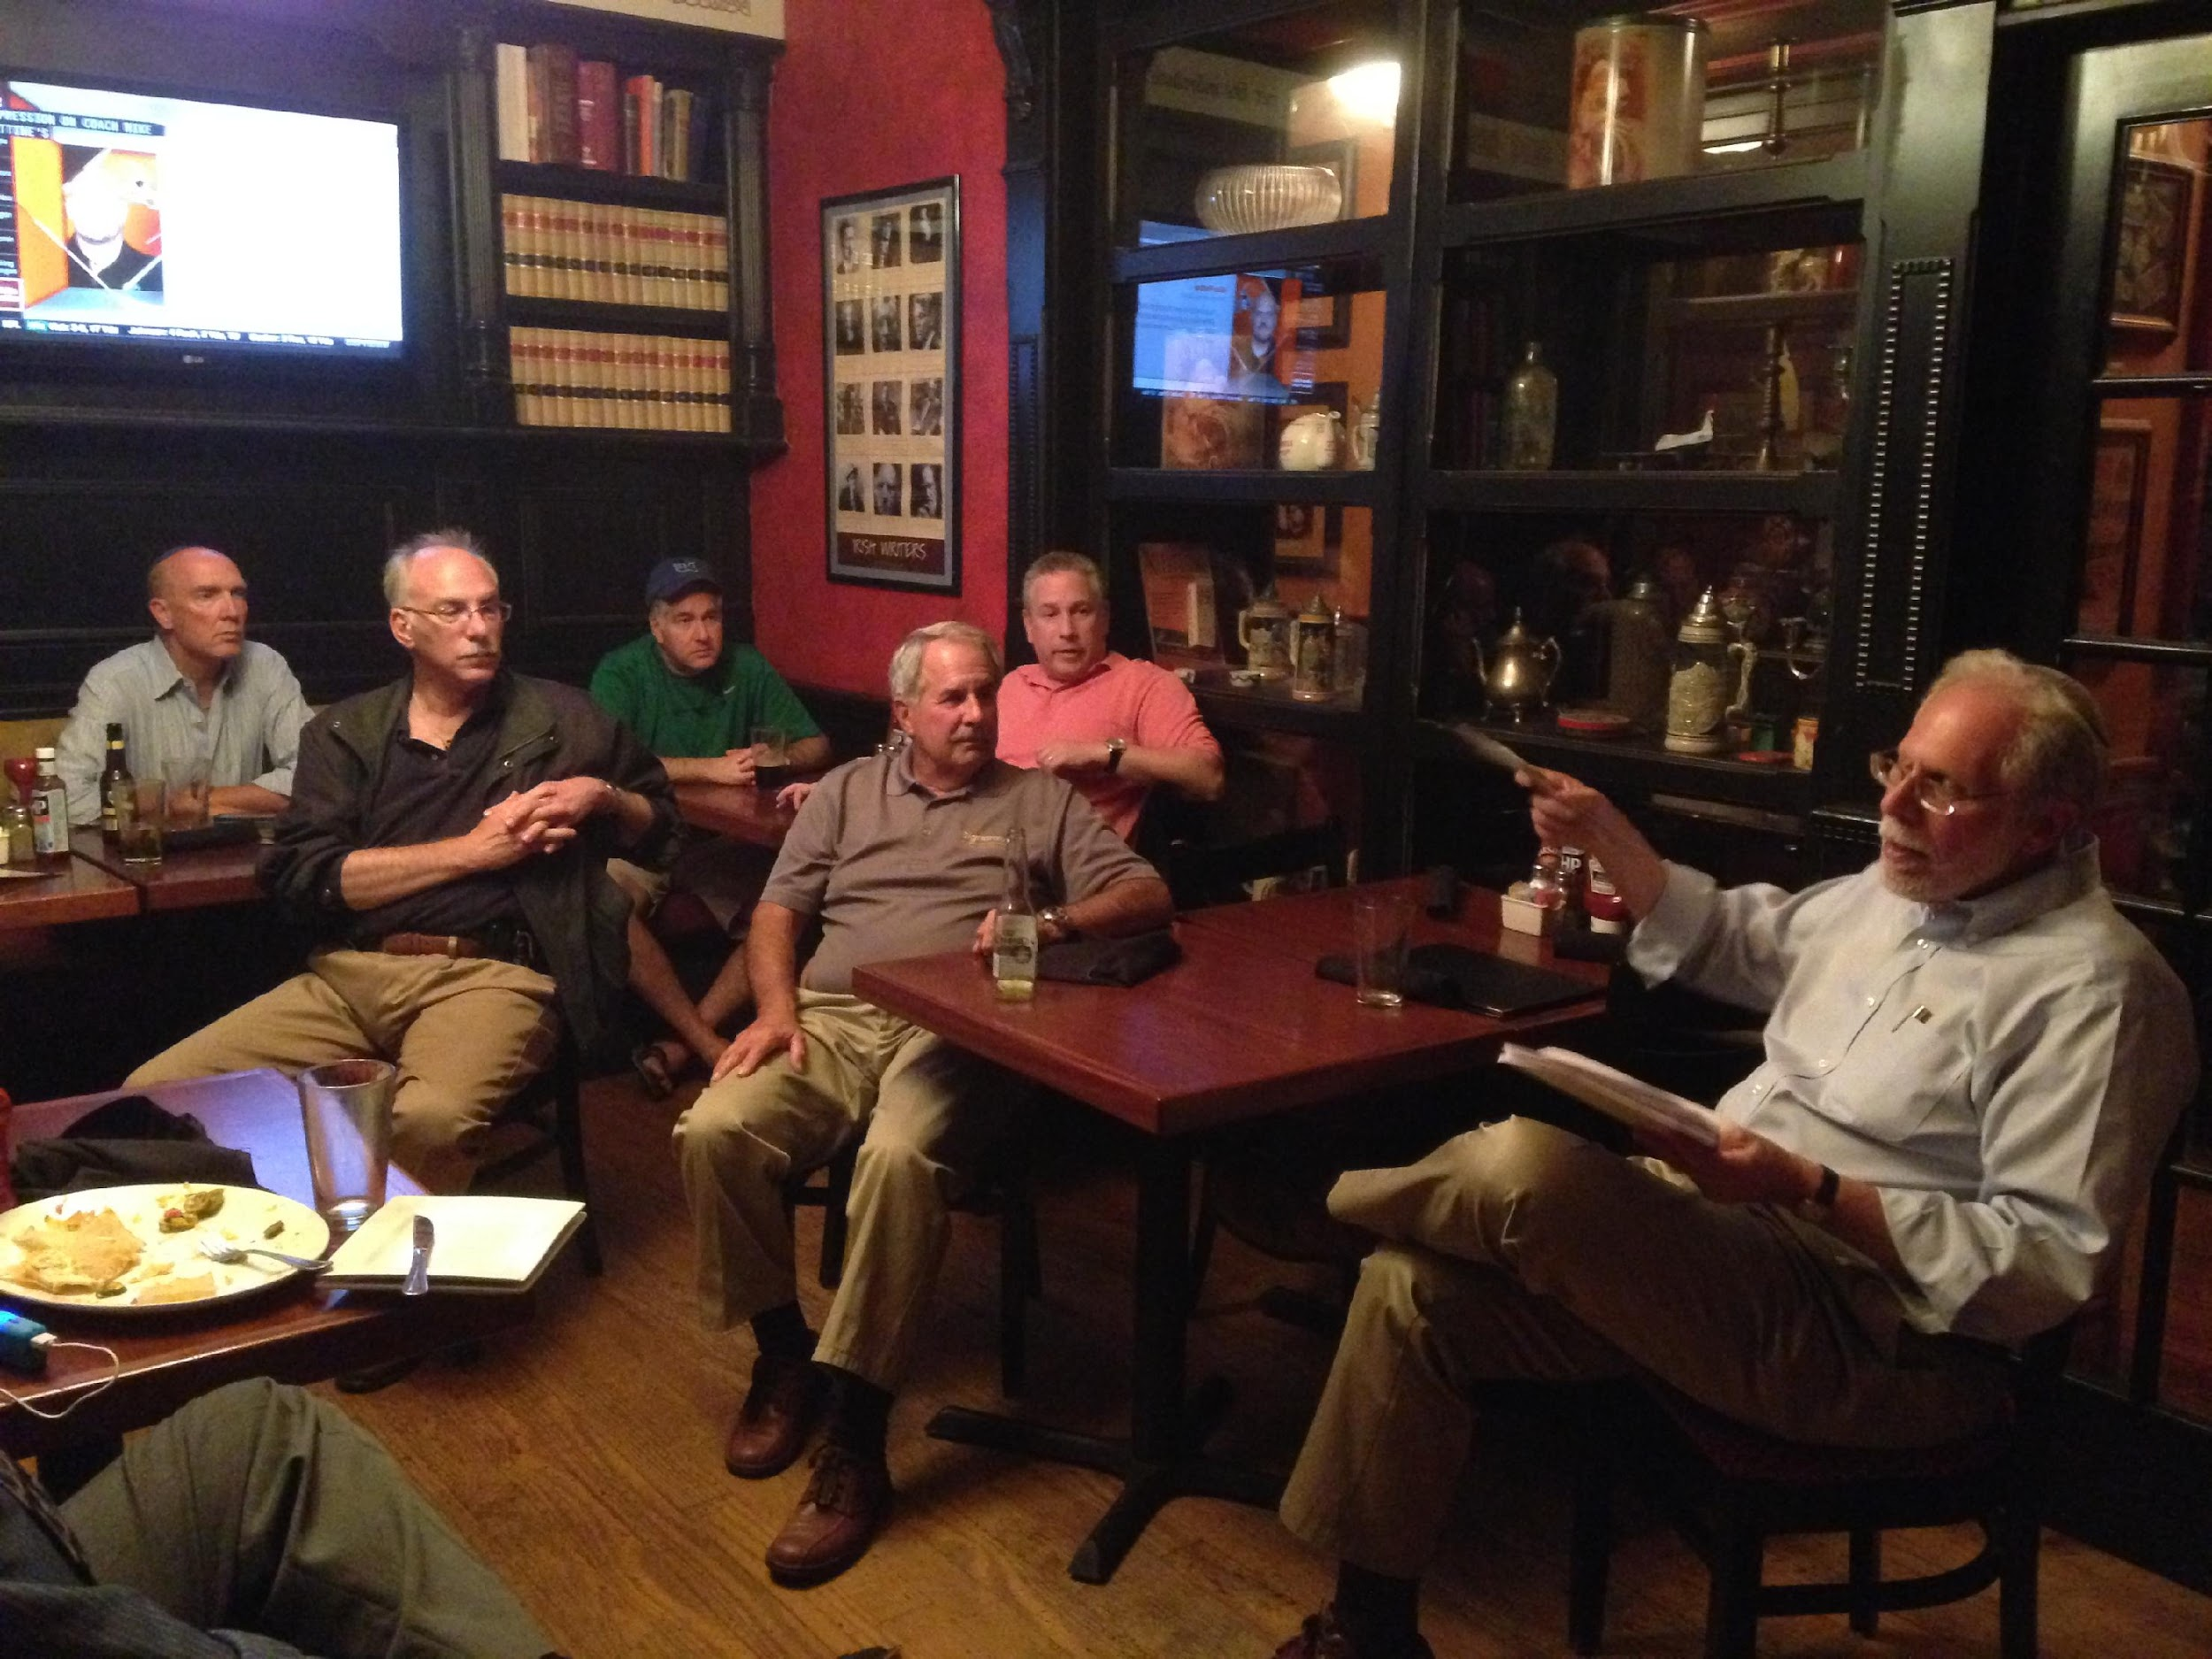
Snapshot of exciting programs: Religious
Men’s Club Shabbat!

Slide 5
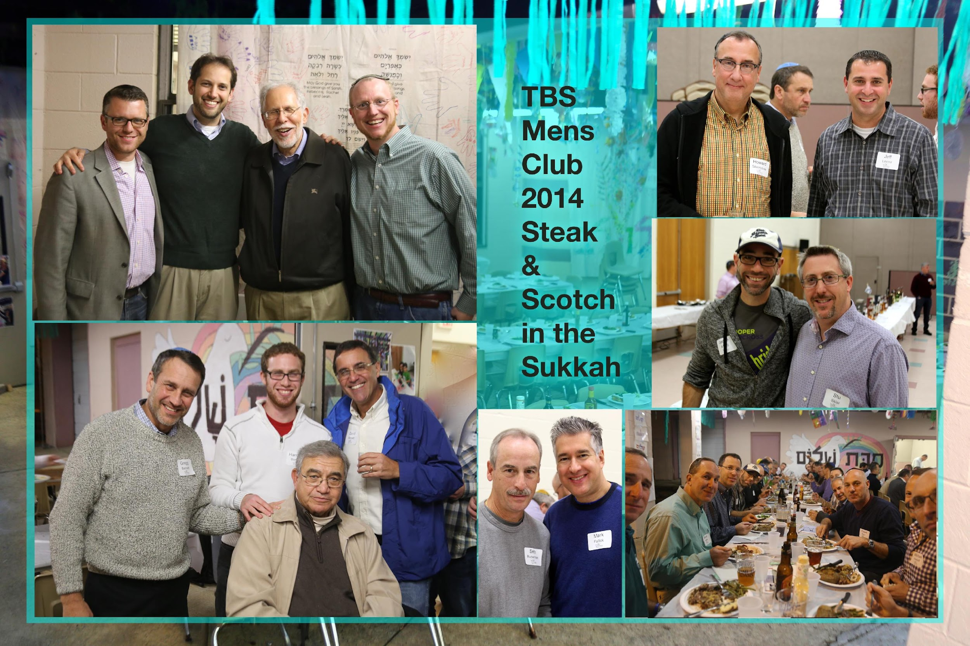
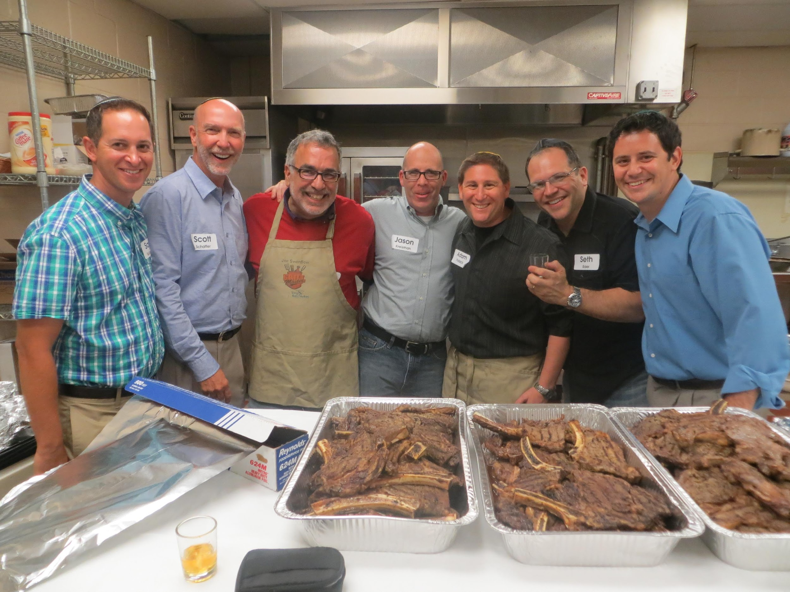
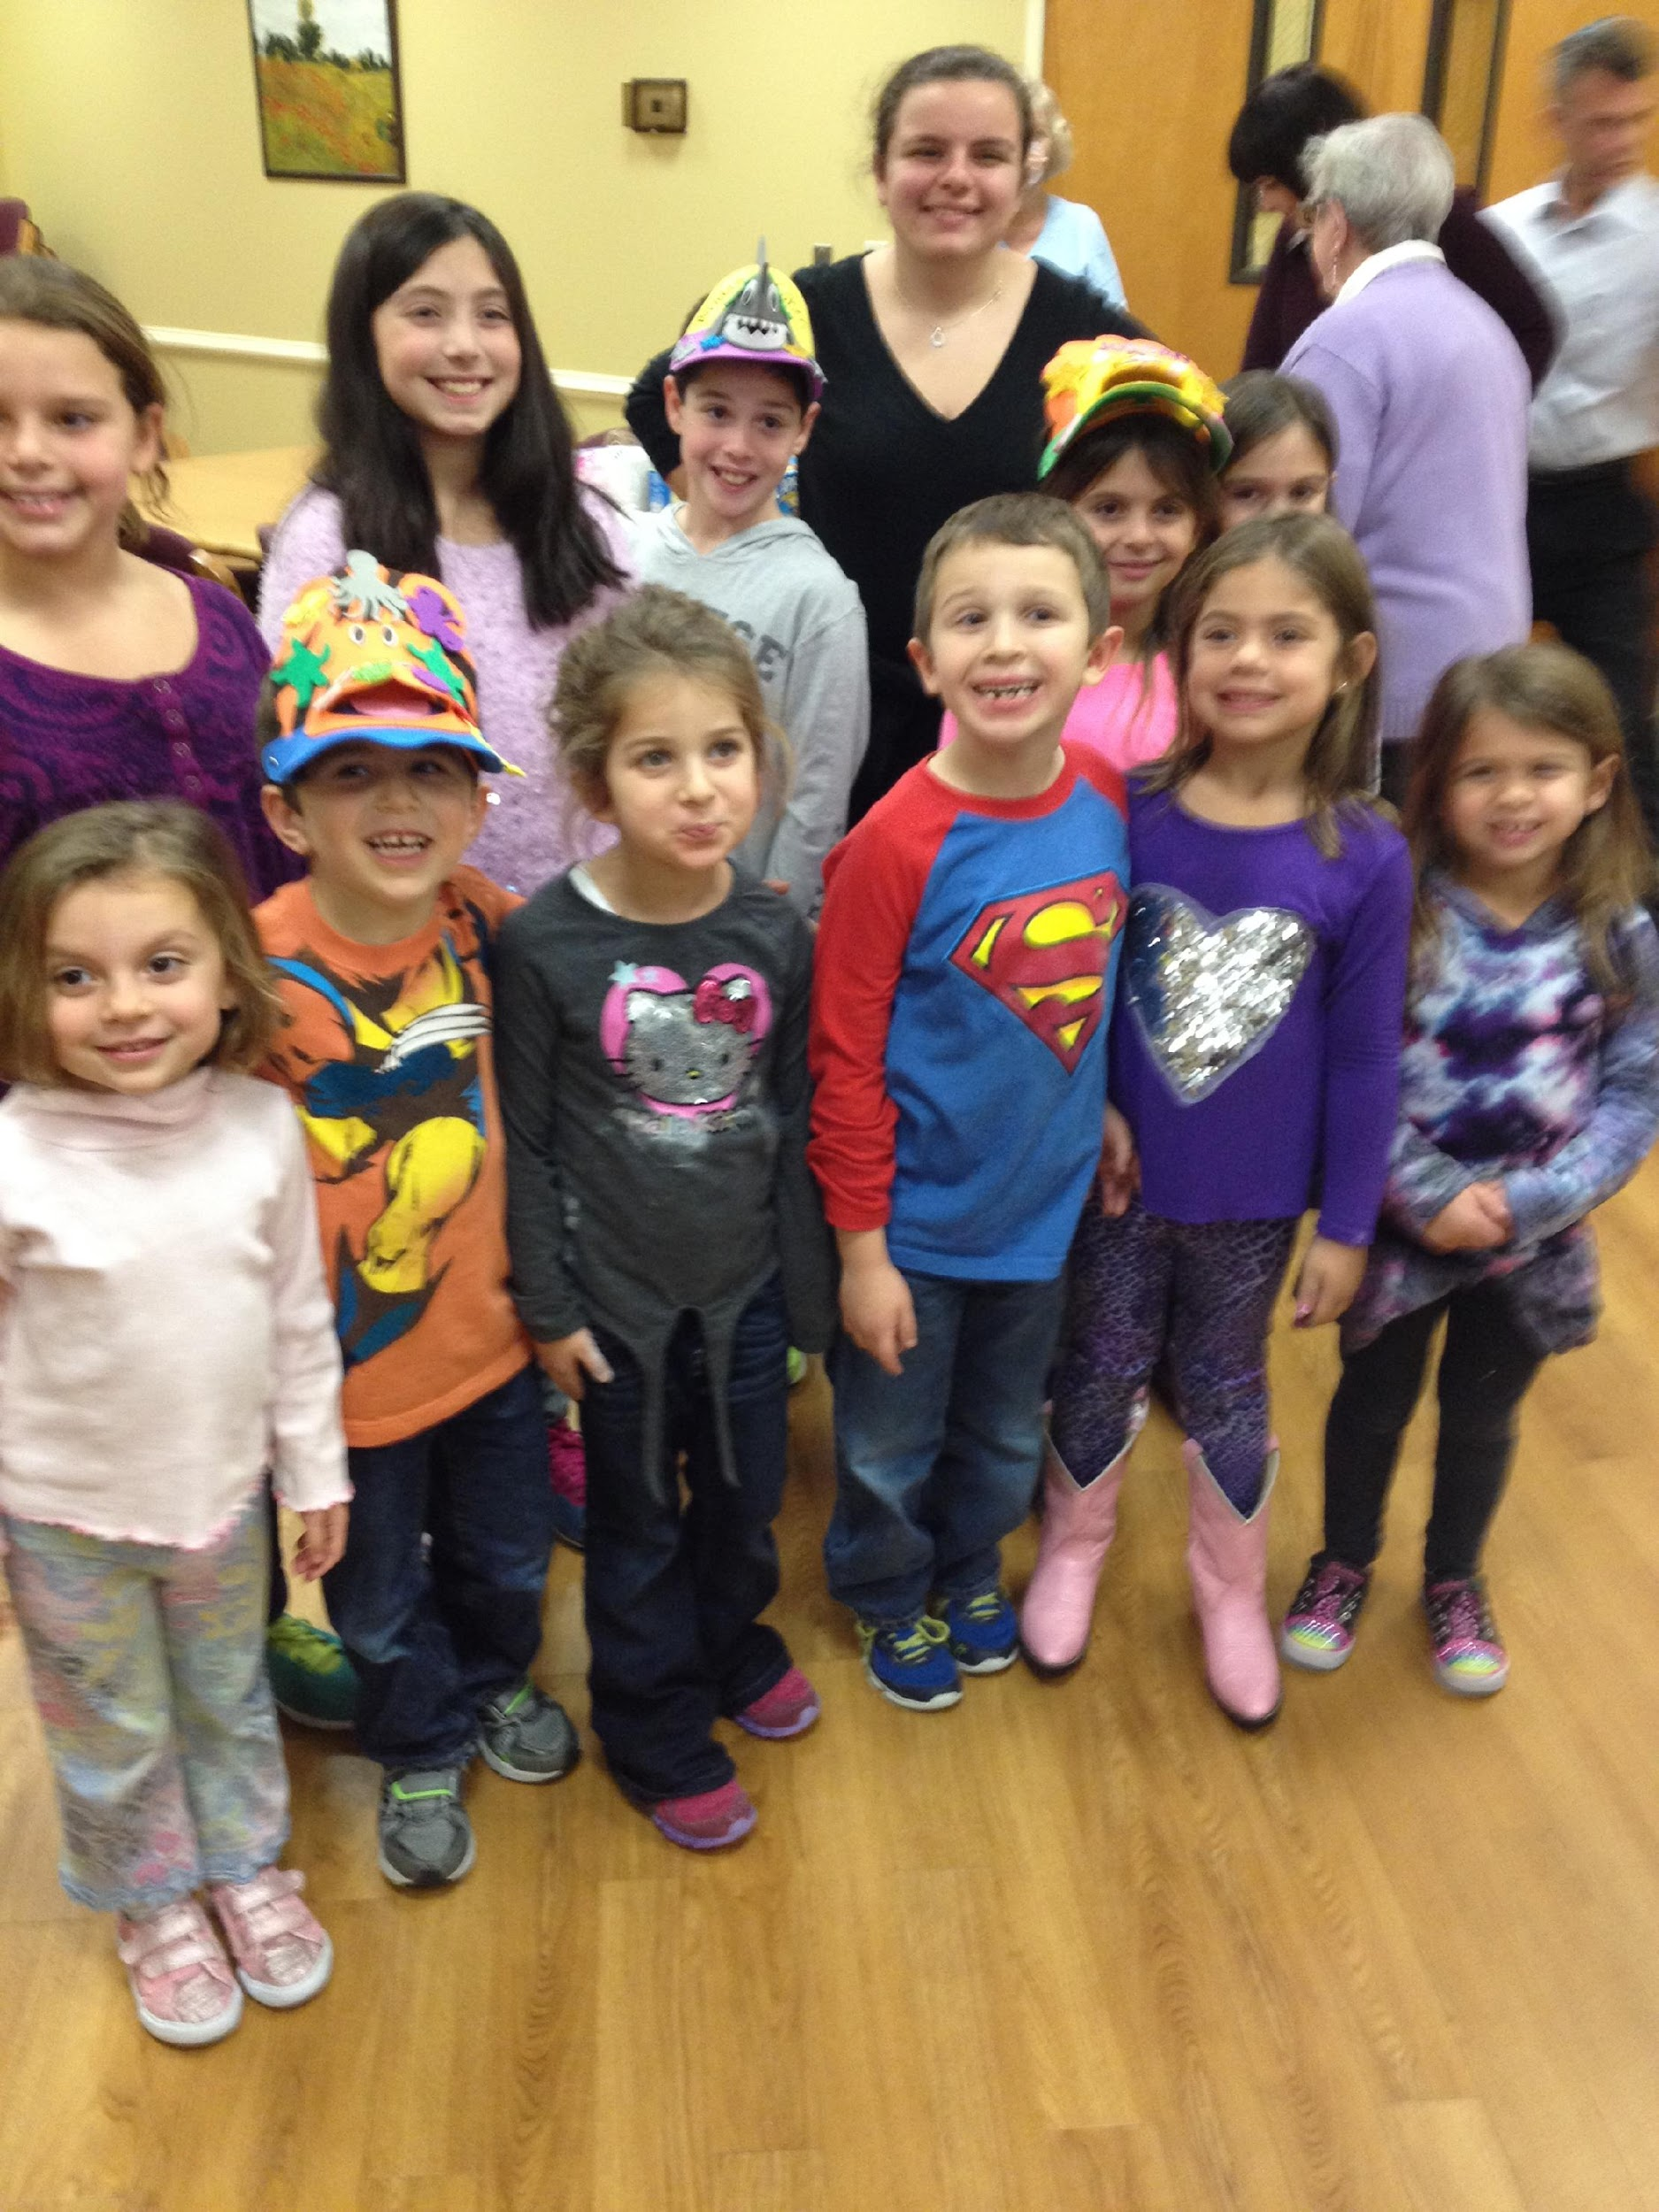
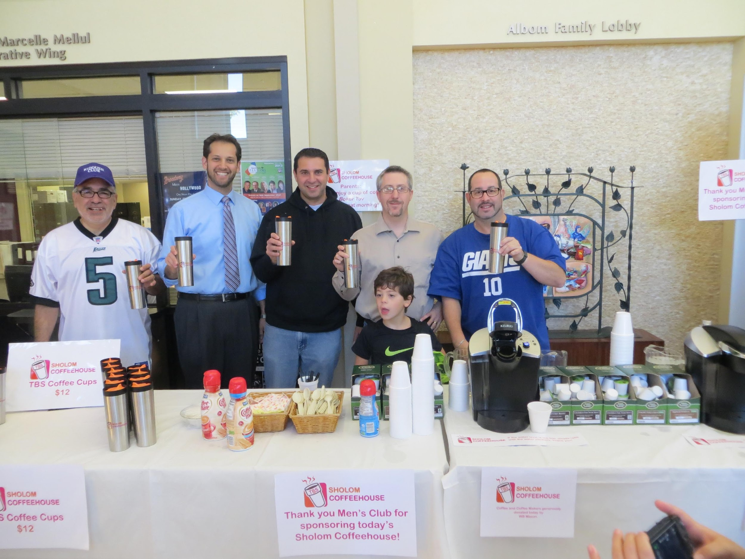
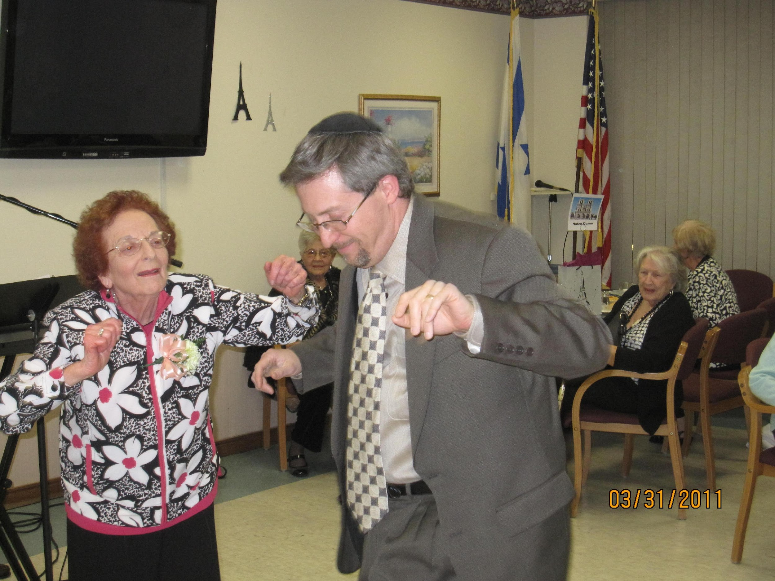
Snapshot of exciting programs: Fundraising/Community

Slide 6
Snapshot of exciting programs: Social

Slide 7
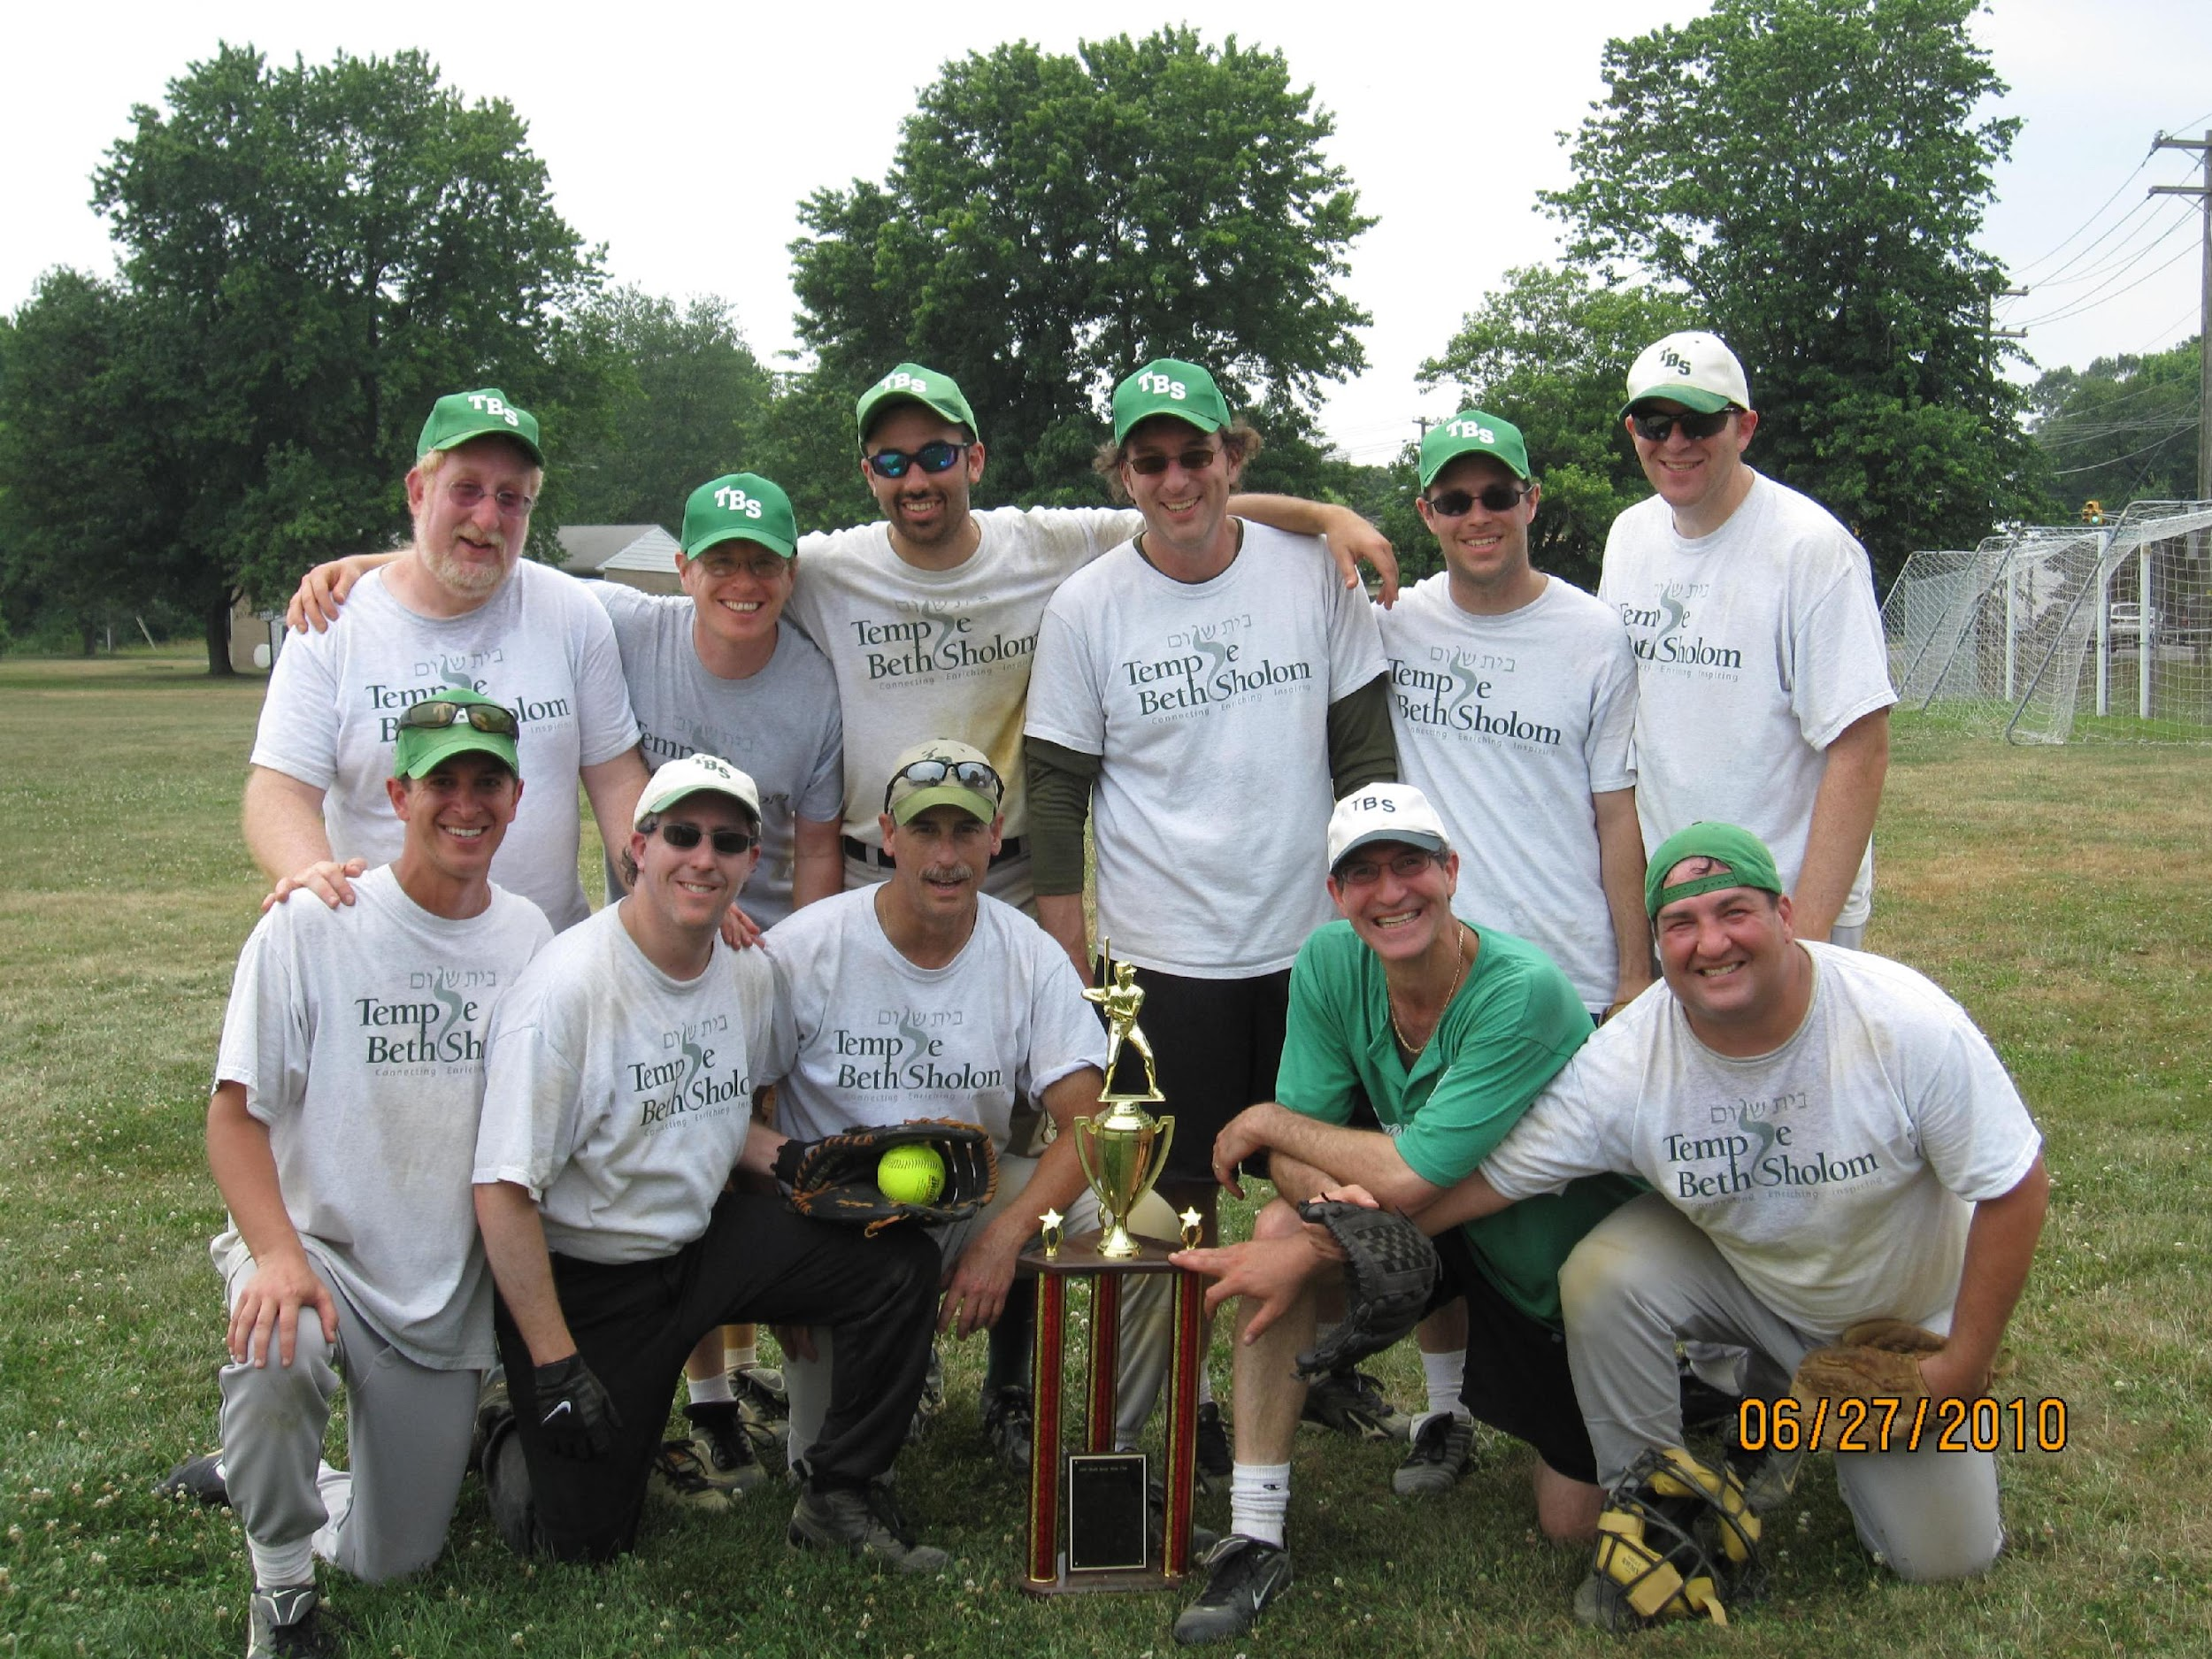
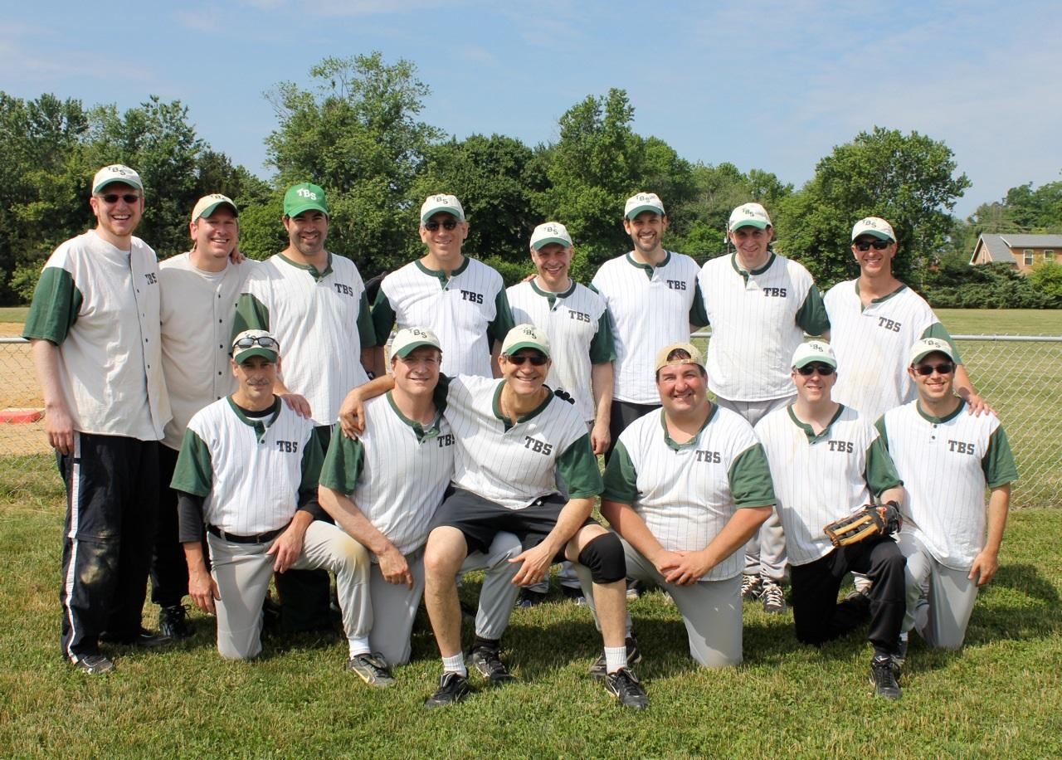
Snapshot of exciting programs: Sports

Slide 8
Or Even if it is helping one of your own!
Dear Team,
Let me begin by thanking all of you for attending our General Board Meeting earlier this week. The Executive Board is following up with those members who couldn't attend the meeting to see what events they want to join, as well as fill them in on what was discussed. Once we capture their information, we will begin sorting out the committees and then follow up with the final board.
As it relates to the open discussion regarding Oren Klein's treatment care plan, I talked with Oren today and below are the dates and details of what Oren and his family will need assistance from us with. Please note, that for Oren’s first trip to Jefferson Hospital on 4/21/15 in Philly, he will be doing it with his wife Joceyln to determine the timing and what’s involved so he can tell us what he needs us to do. There's only one date left to fill. More details coming soon.
The dates we are most concerned about filling at the moment are his Friday-LabCorp days. These are very quick pick up and drop of times in order to monitor his treatment plan. Please pick any time between 8AM and 12:30PM to arrive at a LabCorp locally.
lease fill in and send back to me only (DO NOT REPLY ALL PLEASE):
· Tuesday, 4/21-Jefferson Jocelyn (Philadelphia)
· Friday, 4/24-LabCorp______________Cherry Hill area) (pick time between 8AM-12:30PM)
· Friday, 5/1-LabCorp______________(Cherry Hill area) (pick time between 8AM-12:30PM)
· Friday, 5/8-LabCorp______________(Cherry Hill area) (pick time between 8AM-12:30PM)
· Friday, 5/11-Jefferson Adam Pollack (Philadelphia) (timing TBD)
· Friday, 5/15-LabCorp Sam Sukoneck (Cherry Hill area) 11AM.
· Friday, 5/22-LabCorp______________(Cherry Hill area) (pick time between 8AM-12:30PM)
· Friday, 5/29-LabCorp______________(Cherry Hill area) (pick time between 8AM-12:30PM)
· Friday, 5/31-Jefferson ____________ (Philadelphia) (timing TBD)
· Friday, 6/5-LabCorp______________(Cherry Hill area) (pick time between 8AM-12:30PM)
· Friday, 6/12-LabCorp______________(Cherry Hill area) (pick time between 8AM-12:30PM)
· Friday, 6/19-LabCorp______________(Cherry Hill area) (pick time between 8AM-12:30PM)
· Friday, 6/20-Jefferson Stu Sklar (Philadelphia) (timing TBD)
· Friday, 6/26-LabCorp______________(Cherry Hill area) (pick time between 8AM-12:30PM)
· Friday, 7/3-LabCorp______________(Cherry Hill area) (pick time between 8AM-12:30PM)
Again, thank you for your continued support, cooperation, and dedication.
Be well.
J.

Slide 9
Setting Up Dinners for his family
All,
Thanks very much for your interest in helping Jocelyn, Oren and Eden Klein, as Oren goes through his treatment. As you know from earlier emails, Jason Kreisman is handling coordination for transportation for Oren’s medical appointments. As we discussed at our Men’s Club meeting on Tuesday, 4/14, we are also going to coordinate providing dinners for their family, as much as possible. I have spoken with Jocelyn and she is extremely appreciative of everyone’s support. Some information:
- We will do the schedule in 2 parts. First, we will schedule days for the balance of April and May people would like to help. I will start the schedule for June and July, in mid May.
- Jocelyn is home by 5:30 on Monday and by 5:00 on Tuesday – Friday, so plan on a drop off time at their home at 2012 Queen Anne Road, in Woodcrest of around 5:30.
- The family does not keep Kosher. Please of course feel free to prepare food at your home or you can order food.
- Oren and Eden may be lactose intolerant, but it is not severe. Nonetheless, be cautious in your food selection.
- Oren does have restrictions associated with one of his chemo drugs. Those are below. Please review those and be aware of them in your food selection.
- Dinners should not be processed food.
- If anyone wants to provide a gift card or a monetary amount towards food, please let me know the amount, etc., and I will coordinate that too.
- I will do my best to coordinate so there is not too much of an overlap of type of food if there are back to back nights, etc.
- We have discussed meeting at the Shul kitchen to cook bulk meals for a few nights, to be frozen, etc. If you are interested in helping cook or purchasing food, let me know and I will coordinate the dates and times we will meet at the Shul.
Oren’s Food Restrictions As To His Chemo:
There are certain foods and beverages that may cause bad side effects when taken in combination with this medicine. Your blood pressure may become too high. While you are taking this medicine, and for 2 weeks after you stop taking it, do not eat or drink any of the following:
Beverages: Avoid caffeine (as found in coffee, tea, colas, and chocolate), beer (even some non-alcoholic brands), red wine, sherry, distilled spirits, and all liqueurs.
Dairy and Grains: Avoid most types of strong, aged cheeses and yogurt. Stay away from fava beans; especially if they are over ripened).
Meat or fish: Avoid anchovies, shrimp paste, caviar, beef and chicken livers, or wild game meat. Also avoid using meat extracts, or meat or fish (including dried fish, sausage, bologna, pepperoni, and salami) that is fermented, spoiled, kept un-refrigerated, pickled, prepared with tenderizers, or smoked.
Fruits and Vegetables: Raspberries, figs (either canned or overripe), bananas, dried fruit such as raisins and prunes, avocados. Stay away from miso soup (soybean soup), soy sauce and sauerkraut.
Herbs: Do not take any before consulting your healthcare provider; especially ginseng.
Please email me and let me know:
(A): What day(s) you would like to provide dinner from April 20, 2015 – May 31, 2015;
(B): If you would like to make a contribution to a meal / gift card for dinner; and
(C): If you would like to help with cooking bulk meals at the Shul.
Thanks again for your help – it is very much appreciated. Any questions, please let me know.
Please remember to just reply to me, and do not reply all, to this email.
Shabbat Shalom,
Drew

Slide 10
Being a part of a COMMUNITY!
Dear TBS Men’s Club
I just wanted to say how incredible it is to see the Men's Club step up and come together in support of one of our own. This is what being part of a Jewish community is all about.
Yishar Koach to everybody and thank you.
Shabbat Shalom
RMP

Slide 11
Q & A

