Slide 1
Men’s Club Pandemic Poker 2020
Shaare Torah Men’s Club
Gaithersburg, MD
The FJMC and Shaare Torah do not condone gambling. Consider local regulations as part of your planning.

Slide 2
Benefits of Pandemic Poker
Brings guys together virtually
Builds comradery through competition and shared misery of being homebound
Gets guys some synagogue-sanctioned “me time”
Raises money for Hesed or other synagogue initiative

Slide 3
Things to Consider for Your Tournament
How much should the buy-in for our tournament be?
Suggest $20
What dates/time should our tournament be held?
Suggest Sunday evening at 7:30pm once little kids are asleep
What should the tournament structure be in order to end the tournament at a reasonable hour?
Suggest standard no rebuy tournament. Chip stacks 3,000. Blinds increase every 10 minutes.
How much lead time must you give your membership to make it through the steps to set up accounts for an online poker site?
Suggest at least 3 days after instructions go out
Does the synagogue have a Zoom account or other conference platform you can use for free?
Suggest Zoom with a designated administrator to assign breakout rooms based on table assignments. SUPER RECOMMENDED!
What synagogue initiative should benefit from the tournament?
Suggest Hesed or any other fund that will raise money for Coronavirus-related initiative.
Whom should we invite to the tournament? Synagogue members only? Outside friends? Perspective members? Daycare/Religious School dads? Women?
Suggest starting smaller with only members, perspective members and school dads. Save outside friends for once your system is established. Suggest no gender limitations. When two members of the same household play, they need to be in separate rooms of the house.

Slide 4
Steps to Take Before Going Public with Idea
Download PokerStars “free” software
Not supported by Chromebooks, iPads or iPhones.
Not available in states where internet gambling is legal. In these states, you will need to use the “real money” software instead.
Create a Poker Club (instructions to follow)
Tip: This set up should be performed by a member with experience on PokerStars
Create a Tournament (instructions to follow)
Tip: This set up should be performed by a member with experience on PokerStars
Set up an online payment platform (ex: PayPal, Venmo)
Set up a Zoom meeting to begin 30 minutes prior to tournament start

Slide 5
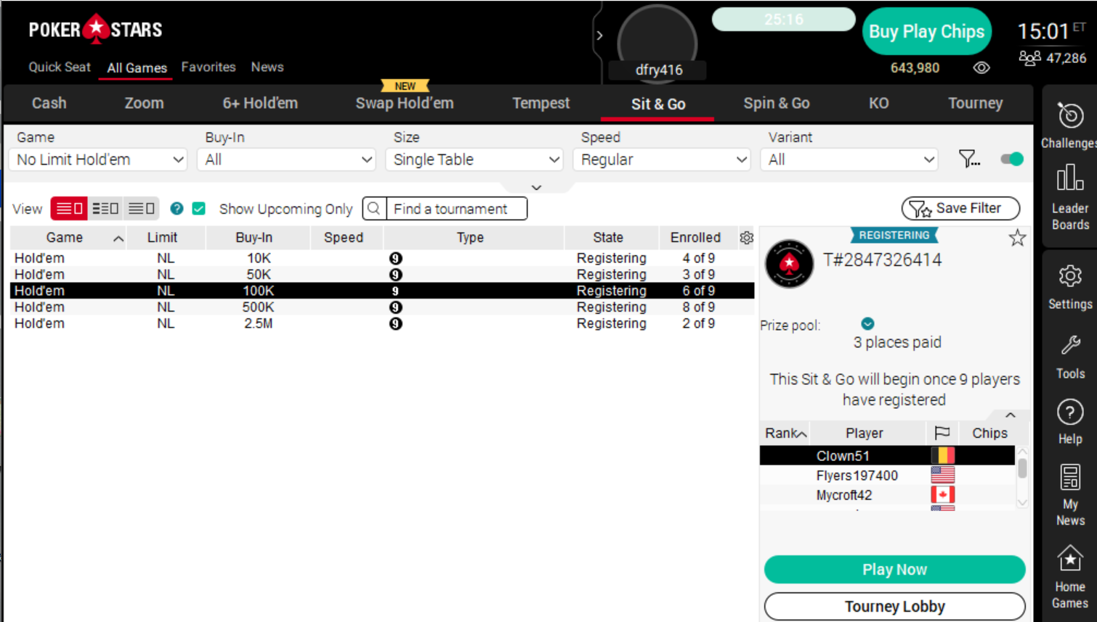
How to Set Up a Poker Stars “Poker Club”
After you have set up your account, on the home screen, select “Home Games” from the menu to the right.
Select “Create a Poker Club” on the left.
Create club name, invitation code, accept terms and conditions and submit.
Enter your club lobby and select “How to Invite New Members” for part of the instructions you will need to send to potential members.

Slide 6
How to Set Up a Club Poker Tournament
Enter your poker club lobby
Select “Manage Games” from the menu across the top of the page
Select “Create a Tournament”
Fill out the form with the details that fit your needs.
Hints:
Use a 20,000 play chip “buy-in”
Breaks are at 55 minutes past the hour no matter when you start. This may result in oddly timed breaks, but the system does not allow customization.
Suggest “Regular” game with no rebuys.
Suggest 10-minute blind intervals and 3,000 chips.
Suggest “Normal” speed game play.

Slide 7
How to Instruct People to Set Up Their Accounts
Start this process at least one week prior to the tournament
Prior to your first tournament, players must:
Send their buy-in electronically
Download the software and register
Join the poker club
Register for the tournament
It is imperative these steps are taken well prior to the start of the tournament.
Trying to get people through these steps in the moments leading up to the tournament is insanely stressful. DO NOT LET IT GET TO THIS.

Slide 8
Sample Language for Invoice
Thank you for joining us for XXXX Men’s Club Pandemic Poker virtual tournament on Sunday, April XX at 7:30pm. $5 from your $20 entry fee will go to support XXXXXXXXXXX to raise money for those affected by the current economic downturn.
After submitting your payment, you will receive instructions via email for how to join the Poker Club and the tournament. In the meantime, please download and install PokerStars to your computer and set up an account. This is a free site, so there will be no request for sensitive/financial information.
We look forward to getting folks together for this virtual competition.
Sincerely,
XXXXXXX Men’s Club

Slide 9
Sample Instructions
The most important part of these instructions is that everybody understands that set up CANNOT WAIT until just before the tournament!!!

Slide 10
Suggestions for Recruiting
START EARLY!
Email to all men – see attached example language
Facebook or other social media posts – see attached example language
Recommend keeping the invite list to members of your own community to increase synagogue comradery.

Slide 11
Tips Based on Experience
Start with an email and/or Facebook post to share that the event is coming (1-2 weeks before tournament)
There is a bit of work to be done by your members to get ready for the tournament
Downloading, setting up an account, joining the poker club and registering for the tournament will bring problems that will take some time to help folks through.
Publicize heavily that these steps must be completed in the days leading up to the tournament.
Provide instructions/Zoom link via email to guys after they register
Identify a Zoom administrator to rearrange guys into breakout rooms based on their table assignments
Sign onto Zoom early to help guys with last minute registration problems
Test the system with core guys a few nights before the tournament
Identify a poker-knowledgeable guy to determine payout structure after registration closes
Make sure guys know that this is the first time you’re trying this and to be patient. Future tournaments will be run more smoothly
Use recruitment for this event as an outreach opportunity to identify members who are not engaged or are having issues requiring rabbinical or lay leadership intervention
RECRUIT RECRUIT RECRUIT!!!

Slide 12
Stay Positive and Good Luck!
All of these steps will be easily completed by a member with past online poker experience
All your volunteers, staff and players are stressed to the max
Older members will require some handholding to get the technology set up
Start planning early to avoid last minute rushing
Contact davidafreiman@gmail.com with questions

