Slide 1

Substance use disorder
Laura Meyers, PhD, ABPP
Psychology Program Manager
Orlando VA Healthcare System

Slide 2
Addiction: Definition
Definition of Addiction:
Addiction is a primary, chronic disease of brain reward, motivation, memory and related circuitry. Dysfunction in these circuits leads to characteristic biological, psychological, social and spiritual manifestations. This is reflected in an individual pathologically pursuing reward and/or relief by substance use and other behaviors.
-American Society of Addiction Medicine (“ASAM”)
Link to ASAM Long Definition of Addiction

Slide 3
ASAM: Addiction conceptualized as…
- Unable to stop using
- Hard to control behavior
- Unhelpful emotions (e.g., shame, guilt)
- Doesn’t fully understand impact on relationships
- Craving

Slide 4
Development: Some Key Points from Research
*Alcohol, nicotine, other drugs and pathological gambling- affect the same reward circuitry that is used to reinforce natural behaviors such as eating and having sex
*Genetic factors account for 50-60% of the likelihood that an individual will develop addiction
* Resiliency factors can affect the extent to which genetic predispositions lead to addiction

Slide 5
DSM 5 Criteria: Alcohol Use Disorder
“Impaired Control” Criteria
Alcohol is often taken in larger amounts or over a longer period than was intended.
There is a persistent desire or unsuccessful efforts to cut down or control alcohol use.
A great deal of time is spent in activities necessary to obtain alcohol, use alcohol, or recover from its effects.
Craving, or a strong desire or urge to use alcohol.

Slide 6
DSM 5 Criteria: Alcohol Use Disorder
“Social Impairment” Criteria
Recurrent alcohol use resulting in a failure to fulfill major role obligations at work, school, or home.
Continued alcohol use despite having persistent or recurrent social or interpersonal problems caused or exacerbated by the effects of alcohol.
Important social, occupational, or recreational activities are given up or reduced because of alcohol use.
“Risky Use of the Substance”
Recurrent alcohol use in situations in which it is physically hazardous.
Alcohol use is continued despite knowledge of having a persistent or recurrent physical or psychological problem that is likely to have been caused or exacerbated by alcohol.

Slide 7
DSM 5 Criteria: Alcohol Use Disorder
“Pharmacological Criteria”
Tolerance, as defined by either of the following:
a) A need for markedly increased amounts of alcohol to achieve intoxication or desired effect.
b) A markedly diminished effect with continued use of the same amount of alcohol.
11. Withdrawal, as manifested by either of the following:
a) The characteristic withdrawal syndrome for alcohol
b) Alcohol (or a closely related substance, such as a benzodiazepine) is taken to relieve or avoid withdrawal symptoms.

Slide 8
How do you get from Use to Abuse?
How does substance use develop into substance abuse (video) | Khan Academy

Slide 9
Rates Substance Use Disorders

Slide 10
Rate of Substance Use Disorders:
U.S. Population
Rate (excluding tobacco)
8-9% …. Or about 1 in 12
Lifetime Risk
Type of Substance
1 in 4 Americans will develop a “non-tobacco” SUD over the course of their lifetime
Alcohol is the most common
For 80% AUD only, another 13% with both AUD & another SUD
Dept. of Vet Affairs, 2015; CDC ,2014 ; Surgeon General, 2016

Slide 11
Alcohol: Recommended Limits
Per National Institutes of Health:
Consistently drinking above these limits correlates with significant negative consequences (medical, legal, psychological, and social)
 | Single-day Limit of “Standard Drink” | Weekly Limit of “Standard Drink”
Men | 4 | 14
Women | 3 | 7
Age > 65 | 3 | 7
Rethinking Drinking

Slide 12
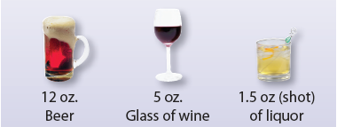
Standard Drink Size
Most drinks consumed in U.S. are larger (or higher alcohol content)

Slide 13
# of Standard Drinks in Bottles
Common Name | Milliliters/ Oz | # of standard drinks
Bottle of wine | 750 ml | 5
“half pint” of 80-poof liquor | 200 ml / 6.7oz | 4.5
“pint” of 80-poof liquor | 375 ml/ 12.9 oz | 8.5
“fifth” or “traveler” of 80-poof liquor | 750 ml / 25.4 oz | 17
“quart” of 80-proof liquor | 946 ml / 32 oz | 21.3
“liter” of 80-proof liquor | 1000 ml/ 33.8 oz | 22.5
Go to www.rethinkingdrinking.com for Drink Size Calculator

Slide 14
Brief Intervention
Script
Recommendations
1. Express concern about patients risk for drinking related health problems
2. Provide education on links between alcohol use and patients’ co-occurring health conditions (if present),
3. Advise patient to abstain (if contraindications) or drink below the recommended limits.
4. Support patient in setting a drinking goal and arrive at a shared decision in treatment plan. Encourage specificity, e.g., cutting down to X number of drinks and documenting intended steps.
5. Suggest treatment referral, if appropriate (e.g., AUDIT-C ≥ 8)
“I am concerned about your use of alcohol because you are drinking above the recommended limits.”
Effective for moderate to high risk drinking (even in non-treatment-seeking populations)
Should only take about 5 minutes
If abstinence is not a realistic option, aim for harm reduction approach
“Because of your [Chronic or co-occurring condition], I am concerned that your alcohol use may impact your health by [relevant repercussion].”
“What do you see as the possible benefits to cutting down?”
If patient indicates no desire to change…
“What would be a sign to you that change would be worth considering?”
“What changes are you willing to make to meet this goal?”
Guth S. Jr Stud Alc Drugs. 2008.
The Management of Substance Use Disorders Working Group; VA/DoD SUD Guidelines. 2009
“Would you be willing to talk to someone to learn about options to support your changes?”
Notes:
Individuals may agree to reduce drinking rather than trying for complete abstinence – consider this approach for patients with fewer alcohol-related problems.¹⁹

Slide 15
Brief Intervention:
Referral Options
Risky Alcohol Use
Brief Intervention
Mutual help groups
Pharmacotherapy
Specialty Care

Slide 16
The 5 6 Stages of Change
After screening: consider their current stage of change!
1. Pre-Contemplation
2. Contemplation
3. Preparation
4. Action
5. Maintenance
“6.”
Return to Use
Click the links for more information:
6 Stages from SMART Recovery
Applying the stages of change
Changing for Good

Slide 17
OPIOID USE DISORDER

Slide 18
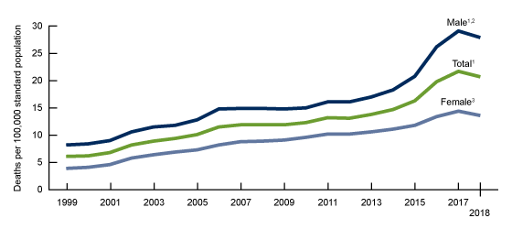
Age-adjusted drug overdose death rates, by sex:
United States, 1999–2018
https://www.cdc.gov/nchs/products/databriefs/db356.htm

Slide 19
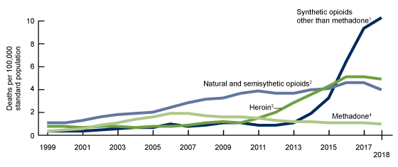
Age-adjusted drug overdose death rates involving
opioids, by type of opioid: United States, 1999–2018
Natural and semisynthetic opioids: Includes drugs such as morphine, codeine, hydrocodone, and oxycodone.
Synthetic opioids other than methadone: Includes drugs such as fentanyl, fentanyl analogs, and tramadol.

Slide 20
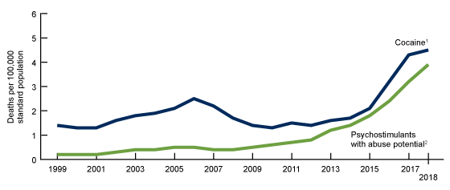
Age-adjusted drug overdose death rates involving
stimulants, by type of stimulant: United States, 1999–2018
Psychostimulants with abuse potential: Includes drugs such as methamphetamine, amphetamine, and methylphenidate.

Slide 21
Signs of an Opioid Overdose
HIGH Risk | OVERDOSE
Muscles become relaxed | Deep snoring or gurgling (death rattle) or wheezing
Speech is slowed/slurred | Blue or grayish skin- usually lips and fingertips begin to darken first
Sleepy looking | Sweaty, clammy skin
Will respond to stimulation like yelling, sternum rub, pinching, etc. | Heavy nod, will not respond to stimulation
Nodding out | Breathing is very slow, irregular, or has stopped/faint pulse

Slide 22
How to Stop Opioid Overdose: Narcan/ Naloxone
Naloxone is an opioid antagonist that can reverse an opioid overdose by blocking opioids from attaching to receptors in the brain.
Naloxone is active for about 30 – 90 minutes in the body.
The naloxone may wear off before the effects of the opioids wear off and the person could go into overdose mode again. This depends on several things, including:
-the person’s metabolism
-how much drug they used in the first place
-how well the liver works to process things; and
-if they use again.

Slide 23
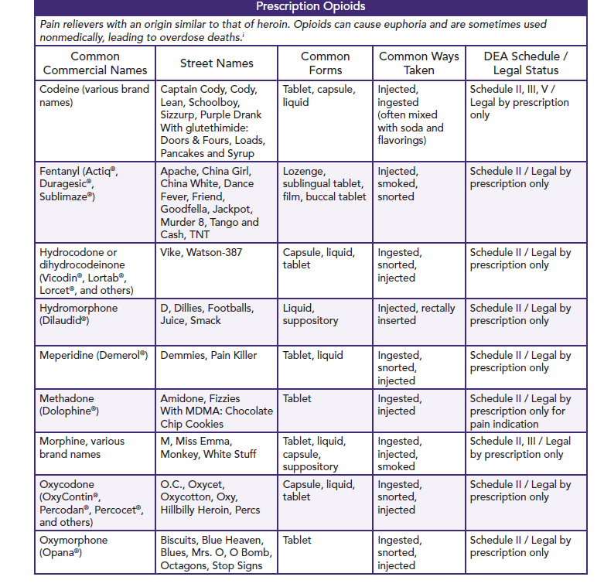
Notes:
Prescription Opioids,
From Appendix D: Facts about Alcohol and Drugs

Slide 24
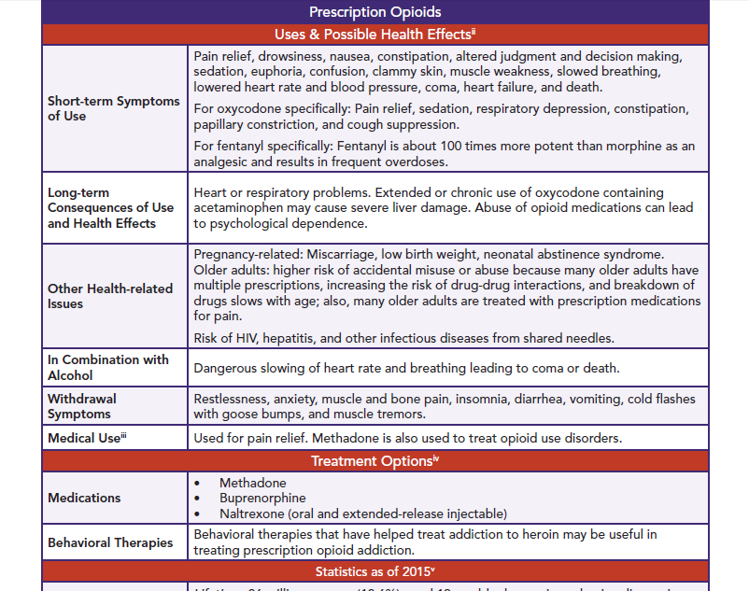

Slide 25
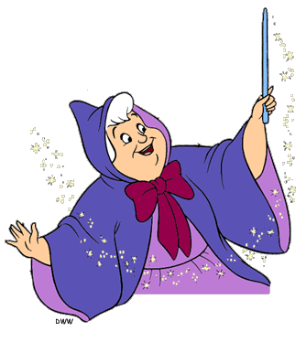
Assessing Motivation for Treatment
When assessing for readiness to change, it is critical that individual reports some internal motivation for behavioral change
For screening, we listen for language that would indicate at least a contemplative stage of change
Professionals are trained to assess and treat- not to make miracles happen

Slide 26
How to move to motivation
Would you rather be right or effective?

Slide 27
Validation:
Validation = Empathy (I care) + Communicating that the client’s perspective makes sense.
Validation is a very powerful behavioral intervention.
NOT PRAISE, nor necessarily agreement
Notes:
EMPATHY: understanding of another's feelings: the ability to identify with and understand somebody else's feelings or difficulties
Emotional piece
Cognitive understanding
ACTION of Empathy
VALIDATION can be a change agent in itself, but more often it is something that sets the stage very well for change.
It is not just something you SHOULD do as a provider.

Slide 28
Levels of Validation
*Validate at the highest possible level
V1: Staying Awake
  Listen with complete awareness. Act interested.
V2: Accurate Reflection
  Repeating his/her statements
V3: Mindreading
  Expand on hints at emotion/thoughts/behaviors. Accurately state the unstated.
V4: Makes sense based on past
  Family history, biological factors, history of invalidation
V5: Makes sense based on current context (anyone would feel this way)
  Move past verbal validation to non-verbal.
V6: Radically genuine
  Sunsets vs. math problems.
Notes:
Level 1: Listen with Complete Awareness
- Be awake, act interested
Level 2: Accurately Reflect the Client’s Communication
- Repeating or rephrasing his or her statements
Level 3: Articulate Non-verbalized Emotions, Thoughts, or Behavior Patterns
- Expand client’s hints at emotions/thoughts/behaviors into full-scale elaboration of feeling or experience.
Level 4: Describe How the Client’s Behavior Makes Sense in Terms of Past Learning History or Biology
- Family history, biological sensitivities, history of invalidation.
Level 5: Actively Search for the Ways that the Client’s Behavior Makes Sense in the Current Circumstances and Communicate This
- Moving past verbal validation to non-verbal
Level 6: Be Radically Genuine
Sunsets rather than math problems.
Male providers example.
Nodding yes.
Sounds like you are uncomfortable with male providers.
Pt who feels uncomfortable working with male providers.
V4: Makes sense considering your history with men.
V5: How are you feeling now working with me. I noticed that you seemed uncomfortable in the room. Your leg has been bobbing up and down – is that anxiety? (V3). Well, that makes sense. I’m a new male provider who you are being asked to work with for the next 12 weeks – and talk about some of the ways you are suffering in your life. Yeah… sounds challenging. Feeling anxious makes some sense. Are other emotions showing up right now too as you sit with me? Sadness?
Is there anything I can do to help with this process?
V6: Crying, getting angry, when a client tells you something painful that has happened to them. “Openly being the feelings and attitudes which at the moment are flowing in him… able to communicate them if appropriate. It means the therapist is being himself or herself, not denying himself or herself.” Sometimes validation is about not trying to fix them and it is about admiring them, about validating the struggles and the resilience in them. Validating that they rise up every morning and show their face.
Mindreading: VERY IMPORTANT. Opening up a person to different emotional outcomes opens them up to more behavioral options. Healthy behavior is typically about increasing the number of behavioral options a person has. Not black or white. Not angry or not angry… sad is an option… fear too… and irreverence.
Unadaptive singular emotions tend to narrow the behavioral repertoire.
I DON’T WANT AN OBJECTIVE THERAPIST? I WANT A REAL HUMAN BEING WHO IS ON MY SIDE!!

Slide 29
Role-play
You’ve noticed that someone close to you (family member, friend, close member of your community) has been drinking more than usual and out at dinner, had trouble walking to the car. You’ve heard from others that they have been missing a lot of work. You’d like to bring it up, but they say they’re fine and nothing is wrong. How can you have a conversation with them with only using validation?

Slide 30
Role of emotions
Emotions
  Provide valuable information
  Motivate behavior
  Love themselves

Slide 31
Guilt
Lets us know we did something wrong
Makes us want to fix it

Slide 32
Shame
Lets us know what we did is so bad, it’s not forgivable and will get us kicked out
Makes us want to hide and keep it a secret

Slide 33
How do these emotions relate to addiction?
Triggers shame when guilt is effective
Solution is to approach, talk, listen, not reject

Slide 34
Emotion | Action Urge | Function | Fit the Facts? Yes | No Opposite Action
Fear/Anxiety | avoid | Safety – protect from danger | Dangerous? avoid | Approach exposure
Sadness | hide, cry | heal, elicit help/support | Lost something recently? grieve & heal | Get out and active Behavioral activation
Guilt “I did something wrong.” | Repair, apologize | repair relationships | Messed up? apologize and fix it | Don’t apologize; do what makes you feel guilty
Shame “I’m a bad person” | hide, secret | keep in the group | They’d reject you? don’t tell | Tell the secret
Anger | attack, yell, ruminate | motivate, protect | Effective? speak up, protect yourself | Gently avoid, think of other’s perspective
Love | be with, talk about | community, enhance life | Help your life? be with | Burn bridges, avoid

Slide 35
Motivational interviewing
Motivational interviewing is a collaborative, goal oriented style of communication with particular attention to the language of change. It is designed to strengthen personal motivation for and commitment to a specific goal by eliciting and exploring a person’s own reasons for change with the atmosphere of acceptance and compassion.
The four integrated elements of Motivational Interviewing are:
Partnership
Acceptance
Compassion
Evocation
Miller & Rollnick, 2013, p.29

Slide 36
To be continued Sunday…

