Slide 1
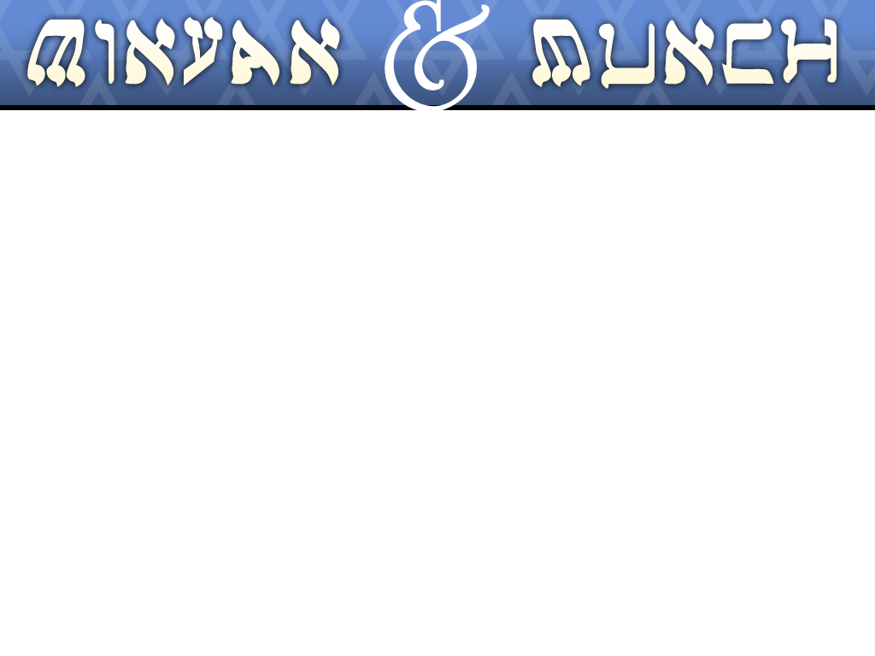
C.B.E. and Men’s Club invites the entire congregation
to join us for
“Minyan and Munch”
Sunday, January 13th
Minyan is at 9 a.m., Munch promptly follows.
After services, please join us for a complimentary breakfast
featuring:
Garden Vegetable and Cheese Frittatas, Artesian Breads, Fresh Fruit Salad, Chobani Non-fat Vanilla Yogurt, Bear Naked All Natural Granola, Assorted Jams and Jelly’s, Coffee, Tea and Juice.
All are welcome for services and to stay for a munch. There is no cost to attend this monthly event.
If you’re interested in honoring a Simcha at a future Minyan and Munch or have questions about this event, please Contact Marc Friedman MFriedman.CBE@gmail.com
Help C.B.E. grow Sunday Morning Minyan, have a nosh, visit with friends old and new.

